Slide 1
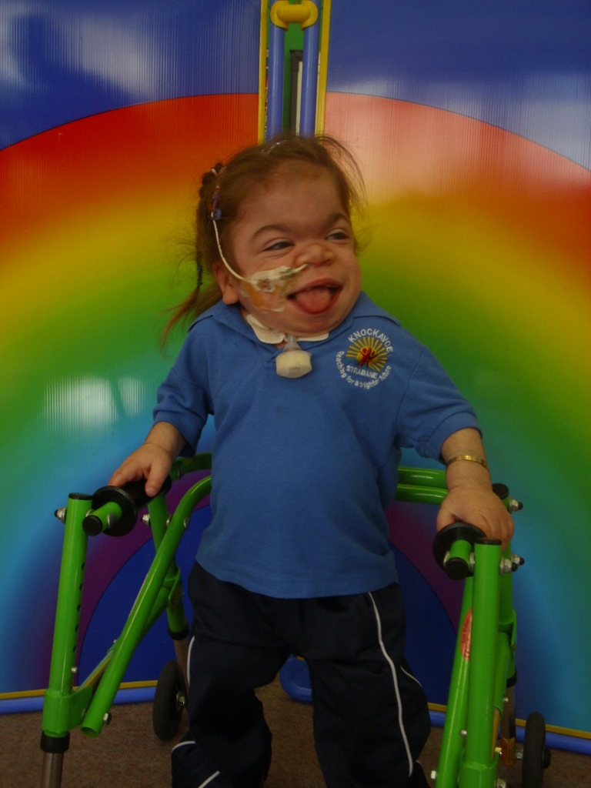
Celebration of Life
Katelyn Mc Donagh

Slide 2
Choir
Hello (Adele)

Slide 3
Welcome
Martina

Slide 4
Poem
Sian

Slide 5
Choir
Special as I can be

Slide 6
Poem
Melissa

Slide 7
Poem
Roisin & Lisa

Slide 8
Solo
Thank you for loving me

Slide 9
Memories from
Liz

Slide 10
Memories from
Health Professionals

Slide 11
Memories of Katelyn
Caroline

Slide 12
Movie

Slide 13
Prayer
Father Doherty

Slide 14
Choir
How great thou Art

Slide 15
Celebration of Life
Katelyn Mc Donagh

